Slide 1
A core Course on Modeling
Introduction to Modeling
0LAB0 0LBB0 0LCB0 0LDB0
c.w.a.m.v.overveld@tue.nl
v.a.j.borghuis@tue.nl
S.8

Slide 2
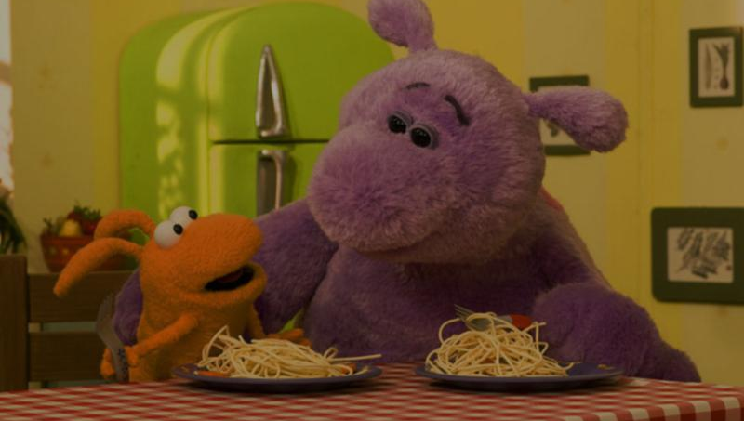
Properties:
serve to distinguish
and sometimes
to order concepts
Notes:
2

Slide 3
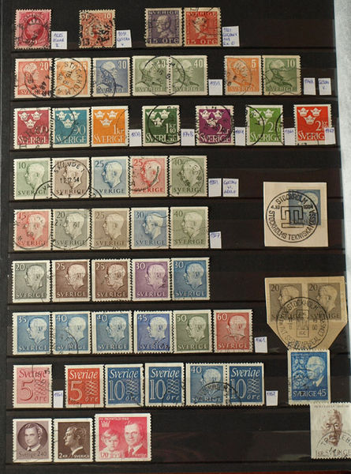
ordering level 1:
nominal
only to distinguish individuals
http://commons.wikimedia.org/wiki/File:Stamp_collection.jpg
numbers may be nominal:
telephone numbers
lottery numbers
social security numbers
...
Notes:
3

Slide 4
ordering level 1:
nominal
only to distinguish individuals
QUIZ
Numbers can occur as nominal labels.
Typically, numbers are used for ordering.
Give an example of ordering without numbers involved.
http://commons.wikimedia.org/wiki/File:Stamp_collection.jpg
numbers may be nominal:
telephone numbers
lottery numbers
social security numbers
...
Notes:
4

Slide 5
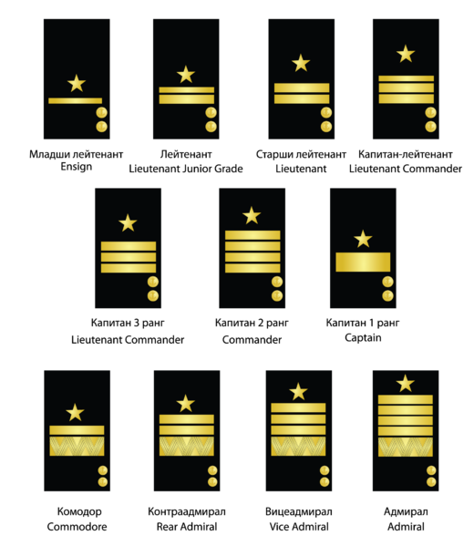
ordering level 2:
ranking
impose an order onto pairs of individuals
http://commons.wikimedia.org/wiki/File:Commissioned_Officer_Rank_Structure_of_the_Bulgarian_Navy_-_sleeve_insignia.png
partial order:
order between some pairs
total order:
order between all pairs
Notes:
5

Slide 6
ordering level 2:
ranking
impose an order onto pairs of individuals
QUIZ
Numbers are totally ordered: for any two non-equal numbers, one of the two is bigger.
What about intervals ([p,q])?
What about fractions (p/q, p and q are both integers)?
What about complex numbers?
http://commons.wikimedia.org/wiki/File:Commissioned_Officer_Rank_Structure_of_the_Bulgarian_Navy_-_sleeve_insignia.png
partial order:
order between some pairs
total order:
order between all pairs
Notes:
6

Slide 7
ordering level 2:
ranking
impose an order onto pairs of individuals
http://commons.wikimedia.org/wiki/File:Commissioned_Officer_Rank_Structure_of_the_Bulgarian_Navy_-_sleeve_insignia.png
physics:
Mohs scale (hardness of minerals)
social sciences:
preferences
Notes:
7

Slide 8
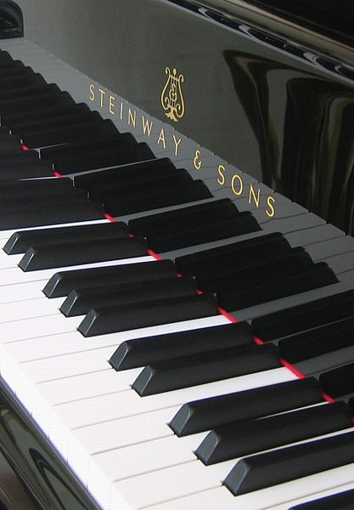
ordering level 3:
difference (or: Interval) scale
difference between values has meaning
http://commons.wikimedia.org/wiki/File:Keyboard_of_grand_piano_-_Steinway_%26_Sons_(Hamburg_factory).jpg
physics:
heat transfer ↔ temperature difference
potential energy
centigrade scale (⁰C)
water height (river)
finance:
± growth
credit / debt
Notes:
8

Slide 9
ordering level 4:
ratio scale
ratio between values has meaning
length:
1 : ½ : ¹/₃
frequency:
1 : 2 : 3
http://commons.wikimedia.org/wiki/File:Vibration_corde_fondamentale_trois_longueurs_petit.gif
physics:
heat transfer ↔ temperature difference
potential energy
centigrade scale (⁰C)
water height (river)
finance:
± growth
credit / debt
physics:
heat contents ↔ absolute temperature (K)
kinetic energy
Kelvin scale (K)
water flow (m³/s)
finance:
% growth
assets
Notes:
9

Slide 10
operation restrictions per ordering level:
 | nominal | partial / total ordinal | interval | ratio
frequency distribution | yes | yes | yes | yes
median
add, subtract
multiply, divide
Notes:
10
Don't forget the essence of purpose here. Example: it is not, in absolute sense, forbidden to talk about the ratio between Centigrades. For instance, on a thermometer, the difference between 20 oC and 0 oC, for the purpose of putting marks on the scale, is twice as large as the difference between 10oC and 0oC allright, despite the fact that the centigrade scale is not a ratio scale. It only means that there is no physically meaningful quantity associated with the ratio between two centigrade temperatures.
A nice example of a misleading ordinal scale is the preference for the 'x-minute egg'. You can make a frequency plot, e.g. of people preferring an x-minute egg; it is also possible to calculate a median on this scale (e.g., '50% of the people prefer their eggs to be cooked less than 4 minutes', but does not make sense to talk about the difference between an x+delta and a x-minute egg being the same as the difference between an y+delta and an y-minute. Other examples are phone numbers: there is no reason why somebody with phone number (p1+p2)/2 would live in between people with phone numbers p1 and p2.

Slide 11
operation restrictions per ordering level:
 | nominal | partial / total ordinal | interval | ratio
frequency distribution | yes | yes | yes | yes
median | no | no / yes | yes | yes
add, subtract
multiply, divide
Notes:
11

Slide 12
operation restrictions per ordering level:
 | nominal | partial / total ordinal | interval | ratio
frequency distribution | yes | yes | yes | yes
median | no | no / yes | yes | yes
add, subtract | no | no | yes | yes
multiply, divide
Notes:
12

Slide 13
operation restrictions per ordering level:
 | nominal | partial / total ordinal | interval | ratio
frequency distribution | yes | yes | yes | yes
median | no | no / yes | yes | yes
add, subtract | no | no | yes | yes
multiply, divide | no | no | no | yes
Notes:
13

